Slide 1
ERASMUS COMMITTEE MEETING
16 March 2018
2013
2016
Notes:
21:47
AGÜ Gençlik Fabrikası
Gençler için gençlerle birlikte daha iyi bir topluma...
Türkiye’de bir ilk olan Gençlik Fabrikası:
• gençleri eğiten,
• yaratıcı ve girişimci olmaya teşvik eden,
• gençlere yaşama dair beceriler kazandıran,
• uluslararası vizyon katan,
• gençlerin toplumsal hayata katılımını sağlayıp bir arada öğrenmenin ve üretmenin keyfine vardıran,
• ulusal ve uluslararası boyutta faaliyet gösteren öğrenen odaklı bir yapıdır.

Slide 2
Agenda Items
Discussion on the extra quotas of student mobility
Discussion on the selection of staff for the new term project
Discussion on the next plans and meetings
2013
2016

Slide 3
Student Mobility Extra Quotas
6 extra quotas
Department | Agreement Quotas | Study mobility Used last year | Internship mobility used last | Applications this year | Quotas this year
Architecture | 9 | 2 | 4 | 26 | 2
Business Administration | 13 | 3 | 4 | 33 | 2
Civil Engineering | 9 | 4 | 0 | 26 | 2
Computer Engineering | 10 | 2 | 3 | 22 | 2
Electrical and Electronics | 24 | 0 | 0 | 29 | 2
Industrial Engineering | 2 | 0 | 11 | 39 | 2
Mechanical Engineering | 2 | 0 | 5 | 30 | 2
Molecular Biology | 2 | 0 | 0 | 9 | 0
2013
2016

Slide 4
Erasmus@AGU 2016
Training Staff Mobility Usage by departments (5 Quotas)
1 | Fatih Yalçın (x2) | Language School | ITC International TEFL Certificate | Czech Republic,Parague
2 | Ceyhun Seyhun Demets | Language School | ITC International TEFL Certificate | Czech Republic,Parague
3 | Yakup Sönmez | International Office | University of Murcia | Spain, Murcia
4 | Gülay Yalçın | Computer Eng. | HIPEAC | Italy
5 | Elif Bengü | Educational Sciences | Graz University | Austria
Consortium +1
2013
2016

Slide 5
Erasmus@AGU 2016
Teaching Staff Mobility Usage by departments (8 Quotas)
1 | Eyüp Doğan | Economics | Friedrich-Alexander University Erlangen (FAU) | Germany
2 | Beniamino Polimeni | Architecture | DICAR Politecnico di Bari | Italy
3 | Ömer Faruk Genç | Business Administration | PFH Private University of Applied Sciences | Germany
4 | Ebru Genç | Business Administration | PFH Private University of Applied Sciences | Germany
5 | Burak Asiliskender | Architecture | University of Applied Arts | Austria
6 | Nilüfer Yöney | Architecture | University of Applied Arts | Austria
7 | Aimilia Voulvouli | Cultural Technology and Communication | University of Aegean | Greece
8 | Heiko Schuss | Business Administration | The University of Rjeka | Croatia
2013
2016

Slide 6
Erasmus@AGU 2017
Teaching Staff Mobility Usage by departments
Name | Department | Institution | Mobility Type
Ömer Faruk Genç | Business Administration | Brest Business School | France
Ebru Genç | Business Administration | Brest Business School | France
Ahmet Önen | Electrical and Electronics | University of Seville | Spain
Prof. Dr. Bülent Yılmaz | Electrical and Electronics Engineering | Piraeus University | Greece
Assistant Professor Yusuf Çağatay Erşan | Civil Engineering | Ghent University | Belgium
2013
2016

Slide 7
Erasmus@AGU 2017
Training Staff Mobility Usage by departments (5 Quotas)
7quotas Left
1 left from 2017 project. This should be used until May 2018
1 | Emeric Abrignani | International Office | University of Murcia | İspanya
2 | İbrahim Alsancak | Political Science and Public Administration | Brno University of Technology | Czech Republic,Prague
3 | İbrahim Hakan Gover | School of Languages
4 | Emeric Abrignani | International Office | Brno University of Technology | Czech Republic,Prague
5
Name | Department | Erasmus Experience Before | Mobility Type
Ömer Faruk Genç | Business Administration | Yes | Teaching
Ebru Genç | Business Administration | Yes | Teaching
Ahmet Önen | Electrical and Electronics | No | Teaching
2013
2016

Slide 8
Erasmus@AGU 2018
Teaching Staff Mobility Usage by departments
3 left from this project
Name | Department | Institution | Mobility Type
Heiko schuss | Business Administration | Alexandur Ioan Cuza University of IASI | Romania
Eyüp Doğan | Business Administration | Alexandur Ioan Cuza University of IASI | Romania
Ali İhsan Özdemir | Business Administration | Brest Business School | France
2013
2016

Slide 9
Erasmus@AGU 2018
Staff mobility applications:
5 applications
1 Teaching
4 Training
Quota for this term
3 teaching staff
6 training staff (1 until 2018 May)
2013
2016

Slide 10
New Applications
Name | Department | Experience | Country | Institution | Dates | Mobility Type
Assistant Prof. Füsun Akdağ | Humaties and Social Sciences | No | Germany | PFH Private Hochshule Gottingen | October | Teaching
Assistant Prof. Gülay Yalçın | Computer Engineering | Yes | Spain | Barcelona Supercomputing Center | June | Training
Prof. Dr. Bülent Yılmaz | EEE | Yes | Austria | Geger Technologies | April | Training
Yakup Sönmez | International Ofifce | Yes | Hungary | Budapest Metrpolitan Universty | March | Training
Ali Özdemir | Health, Culture and Sport | No | hungary | Budapest Metrpolitan Universty | March | Training
2013
2016

Slide 11
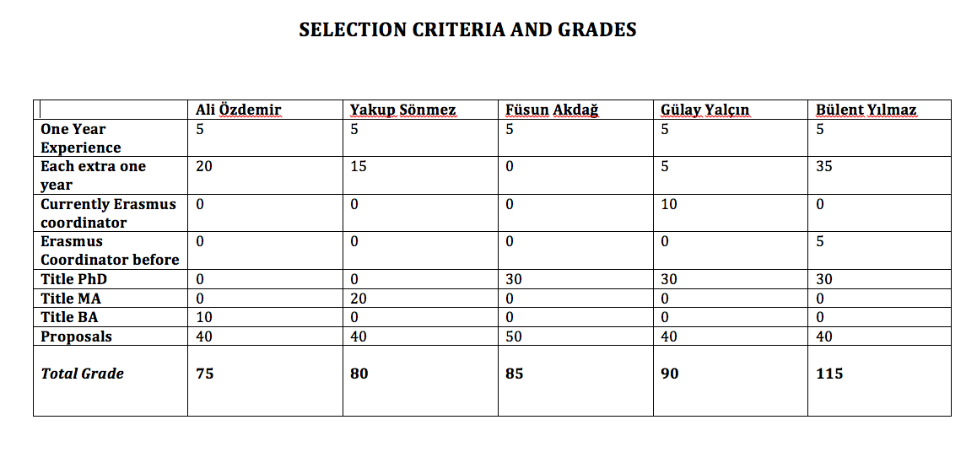
New Applications
2013
2016

Slide 12
Erasmus@AGU 2017
Criteria for staff mobility:
At least one year of work experience at AGU: + 5 points
For each extra year of work experience at AGU: + 5 points
Currently, Erasmus Department Coordinator/Assistant: +10 points
Previous Erasmus Department Coordinator/Assistant: + 5 points
First time Erasmus applicant: +30 points
Academic personnel of Faculties/Schools with Ph.D. Titles: +30 points
Support academic personnel of Faculties/Schools with M.Sc./M.A Titles: +20 points
Support academic personnel of Faculties/Schools with B.Sc./B.A Titles: +10 points
2013
2016

Slide 13
Erasmus@AGU 2017
Criteria for staff mobility:
Language Level 1 : + 40 points for KPDS/YDS .GE. 90, TOEFL IBT .GE. 108
Language Level 2 : + 30 points for KPDS/YDS .GE. 80, TOEFL IBT .GE. 96
Language Level 3 : + 20 points for KPDS/YDS .GE. 70, TOEFL IBT .GE. 84
Language Level 4 : + 10 points for KPDS/YDS .GE. 60, TOEFL IBT .GE. 72
Here .GE. stands for “Greater than or Equal to”. One can get a Language Point from only one of the Language Levels.
For presentation proposals that introduces the research activities, their budgets and the project based RA scholarships at AGU: +10 points
For presentation proposals that promotes the joint research collaborations between the two institutions: +10 points
For presentation proposals that promotes graduate studies at AGU for candidate grad students: +10 points
For presentation proposals that promotes academic exchange activities between the two institutions: +10 points
For presentation proposals that promotes undergrad and grad student exchange activities between the two institutions: +10 points
2013
2016

Slide 14
What’s Next?
Next Call
Next Committee Meeting
2013
2016

Slide 15
Thank you for your participation!
2013
2016

